Slide 1
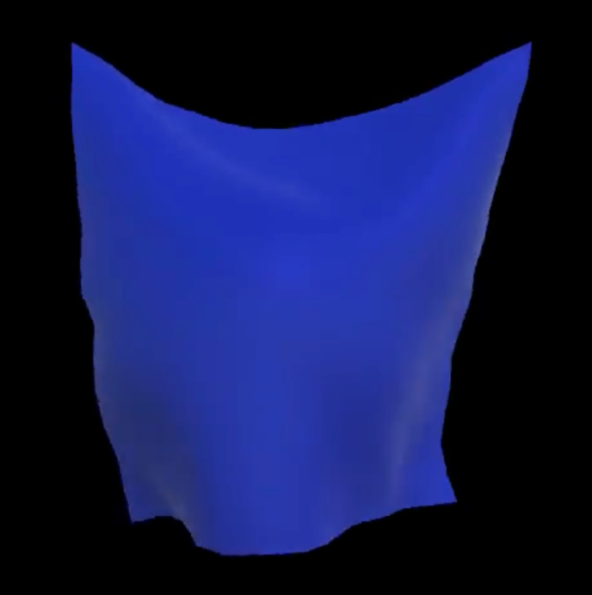
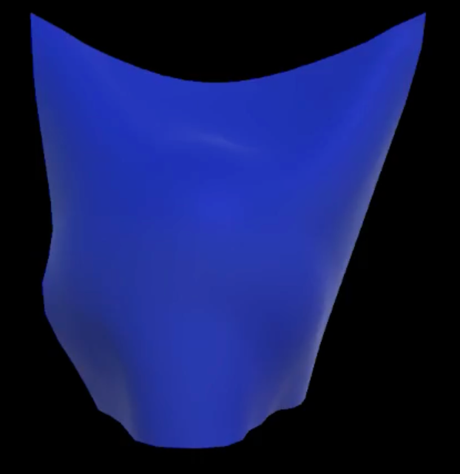
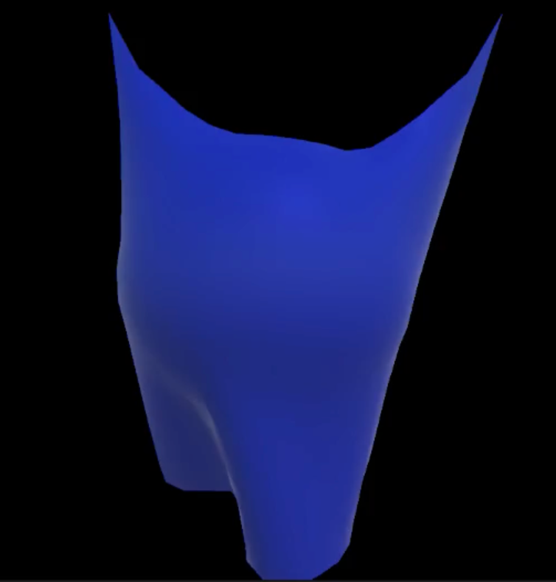
Cloth Simulation in Game Engine
Explicit Euler
Implicit Euler
Fast method
Notes:
My topic is
Cloth is a very interesting and complicated subject in computer graphics. Simulation of Cloth in Games and Animation plays a significant role.
If the simulation can be taken to where the cloth behaves as real as in the real world then it can be used in many applications. Like games and designing
However, there are many technical challenges: rendering complexity of cloth structures, rendering speed, realistic cloth behavior.
We would talk about some technical methods to solve these problems

Slide 2
Overview
Mass-Spring model
Comparison of time integration algorithms
Run time and stability
Collisions with object
Self collision

Slide 3
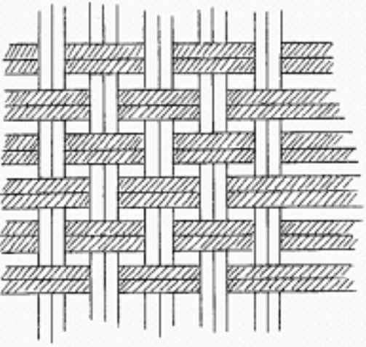
Model: Mass-Spring
Notes:
First of all: strings weave together
How physics works for cloth? Cloth can be generally modeled as a bunch of little particles with varying tightness strings holding them together
How to model Cloth simulation: Geometric methods, physic mehods, Particle/energy methods
Mass - spring
One of the simplest physics cloth models is as follows: consider the sheet of cloth. Divide it up into a series of approximately evenly spaced masses M. as red dot shown , it’s connect nearby masses by a spring (black line) , and use Hooke's Law and Newton's 2nd Law as the equations of motion. We also need to add some other features like spring damping or angular springs, can be made. A mesh structure proves invaluable for storing the cloth and performing the simulation directly on it. Each vertex can store all of its own local information include velocity, position, forces, and when it comes time to render, these information also allows for immediate rendering as a normal mesh.

Slide 4
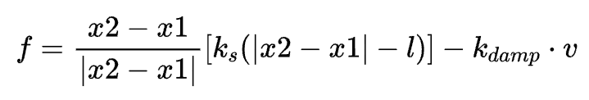
Mass-Spring Physics
Structure(Stretch) spring
Shear spring
Bend spring
Spring motion based on Hooke’s law
f
-f
l
f = k*x
x2
x1
Notes:
Hooke’s law
Struct spring，to provide extend and compress forces
Shear springs (angular), to provide shear force when the cloth is shear-deformed
Bending springs: to avoid over-folding of the springs
Spring’s motion based on hooke’s law
In physics, Hooke's law is an empirical law which states that the force (F) needed to extend or compress a spring
F_{s} = kx,
k is a constant factor characteristic of the spring (i.e., its stiffness),

Slide 5
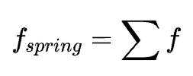
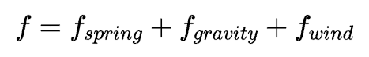
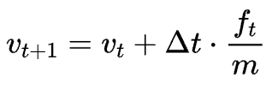
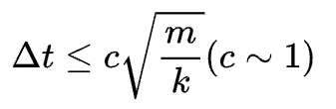
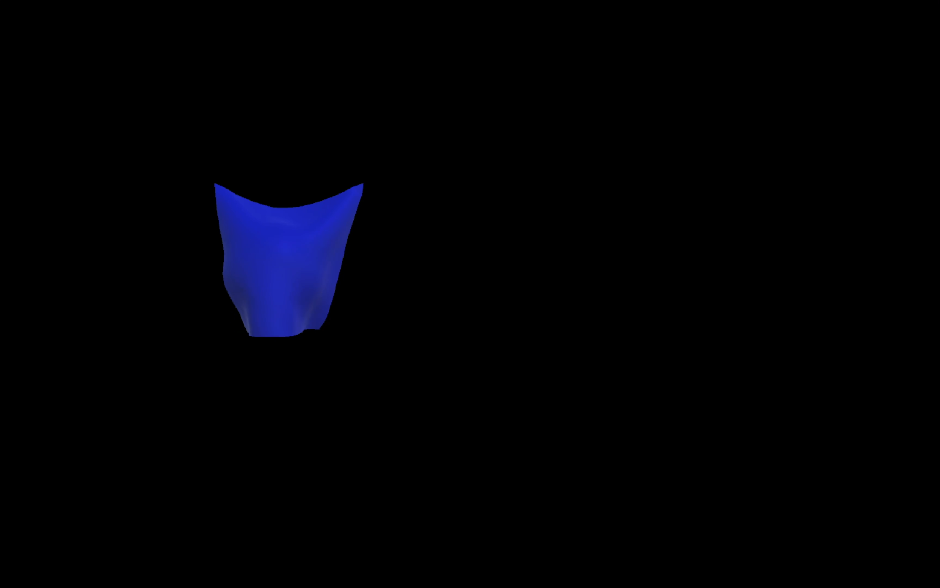
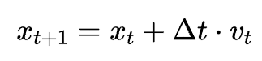
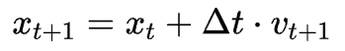
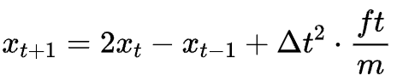
Time Integration Algorithms
Explicit Euler
Semi-Implicit Euler (Explicit)
Verlet algorithm (Explicit)
To avoid exploration, the time step has very strict limitation
Notes:
Force: spring, wind and gravity
After we got the cloth physics model, we need a method to integrate the equation of motion. Assuming our model is newtonian, we have at every vertex defined a position and velocity at each time step t, and our equation of motion tells the acceleration of each vertex at time t, and we want to know the position and velocity at the next time step.
The simplest method for integrating our equations is Explicit Euler's method. It goes like this:
semi-implicit because it computes the velocity explicitly, but the new position implicitly.
This helps reduce the feedback (positive or negative) and can greatly improve stability, at no cost in algorithmic complexity.
The Verlet integration algorithm, does not need to calculate the velocity; it computes new position via the position at both the current and previous time step.
More accurate, but compared to other algorithms,

Slide 6
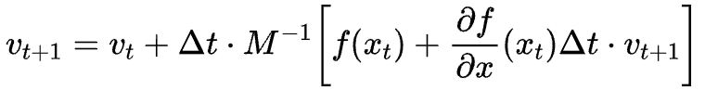

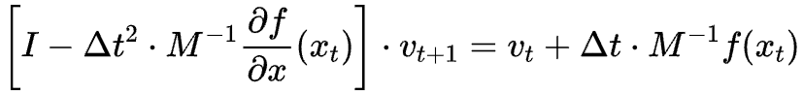
Implicit Euler
Unconditional stable
Slow -> need large time steps
Temporal details disappear
Jacobian method -> get similar velocity
Notes:
Newton’s iteration, don’t need to think about time step, using iteration to get the limitation
Jacobian iteration

Slide 7
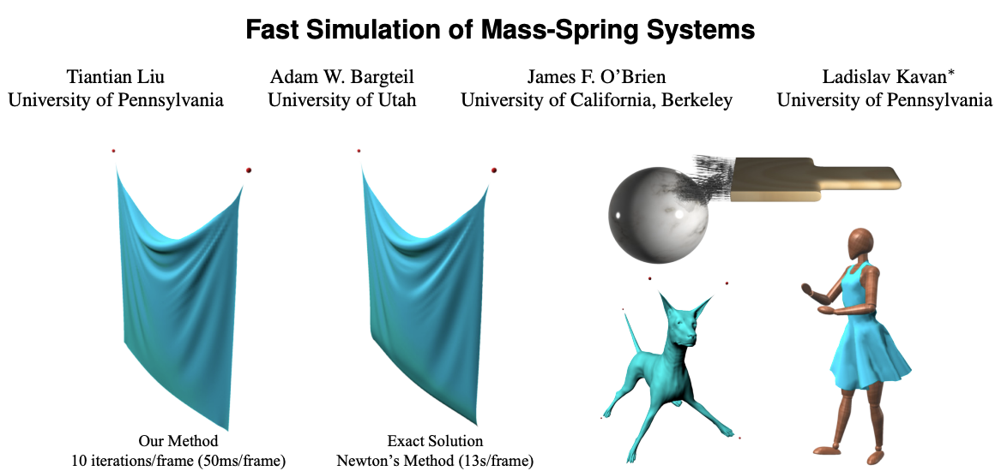

Fast Mass-Spring
Notes:
There is also many state of art solutions to solve the integration
This paper describes a new method for time integration of mass-spring systems. This method provides a fast solution for classical springs. and express the widely used implicit Euler method as an energy minimization problem, Because the global linear system does not depend on run-time state, the matrix can be pre-factored, allowing for very fast iterations.

Slide 8
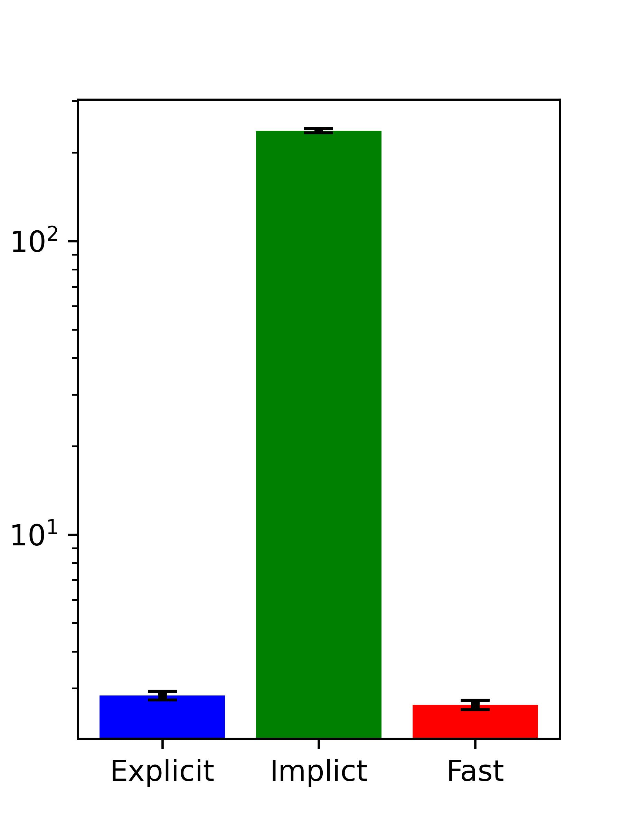
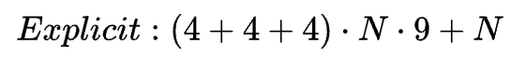
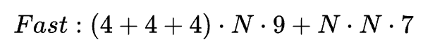
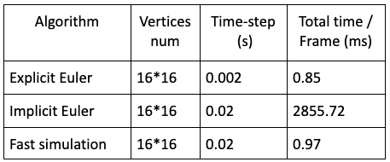
Comparison of 3 methods
Time Complexity:
Time / Frame (ms)
Notes:
The methods we talked above, the time complex is shown here:
And the computing time each frame is show here

Slide 9
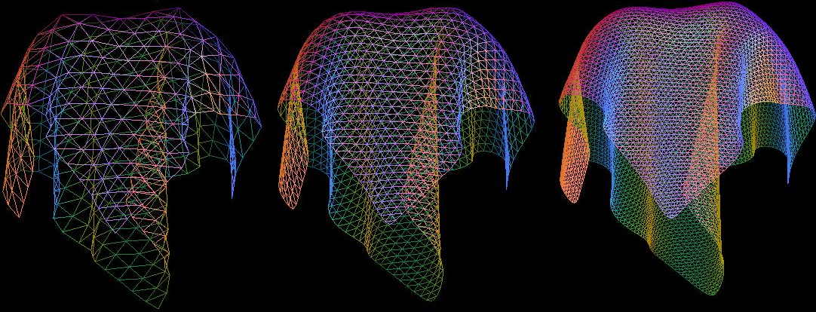
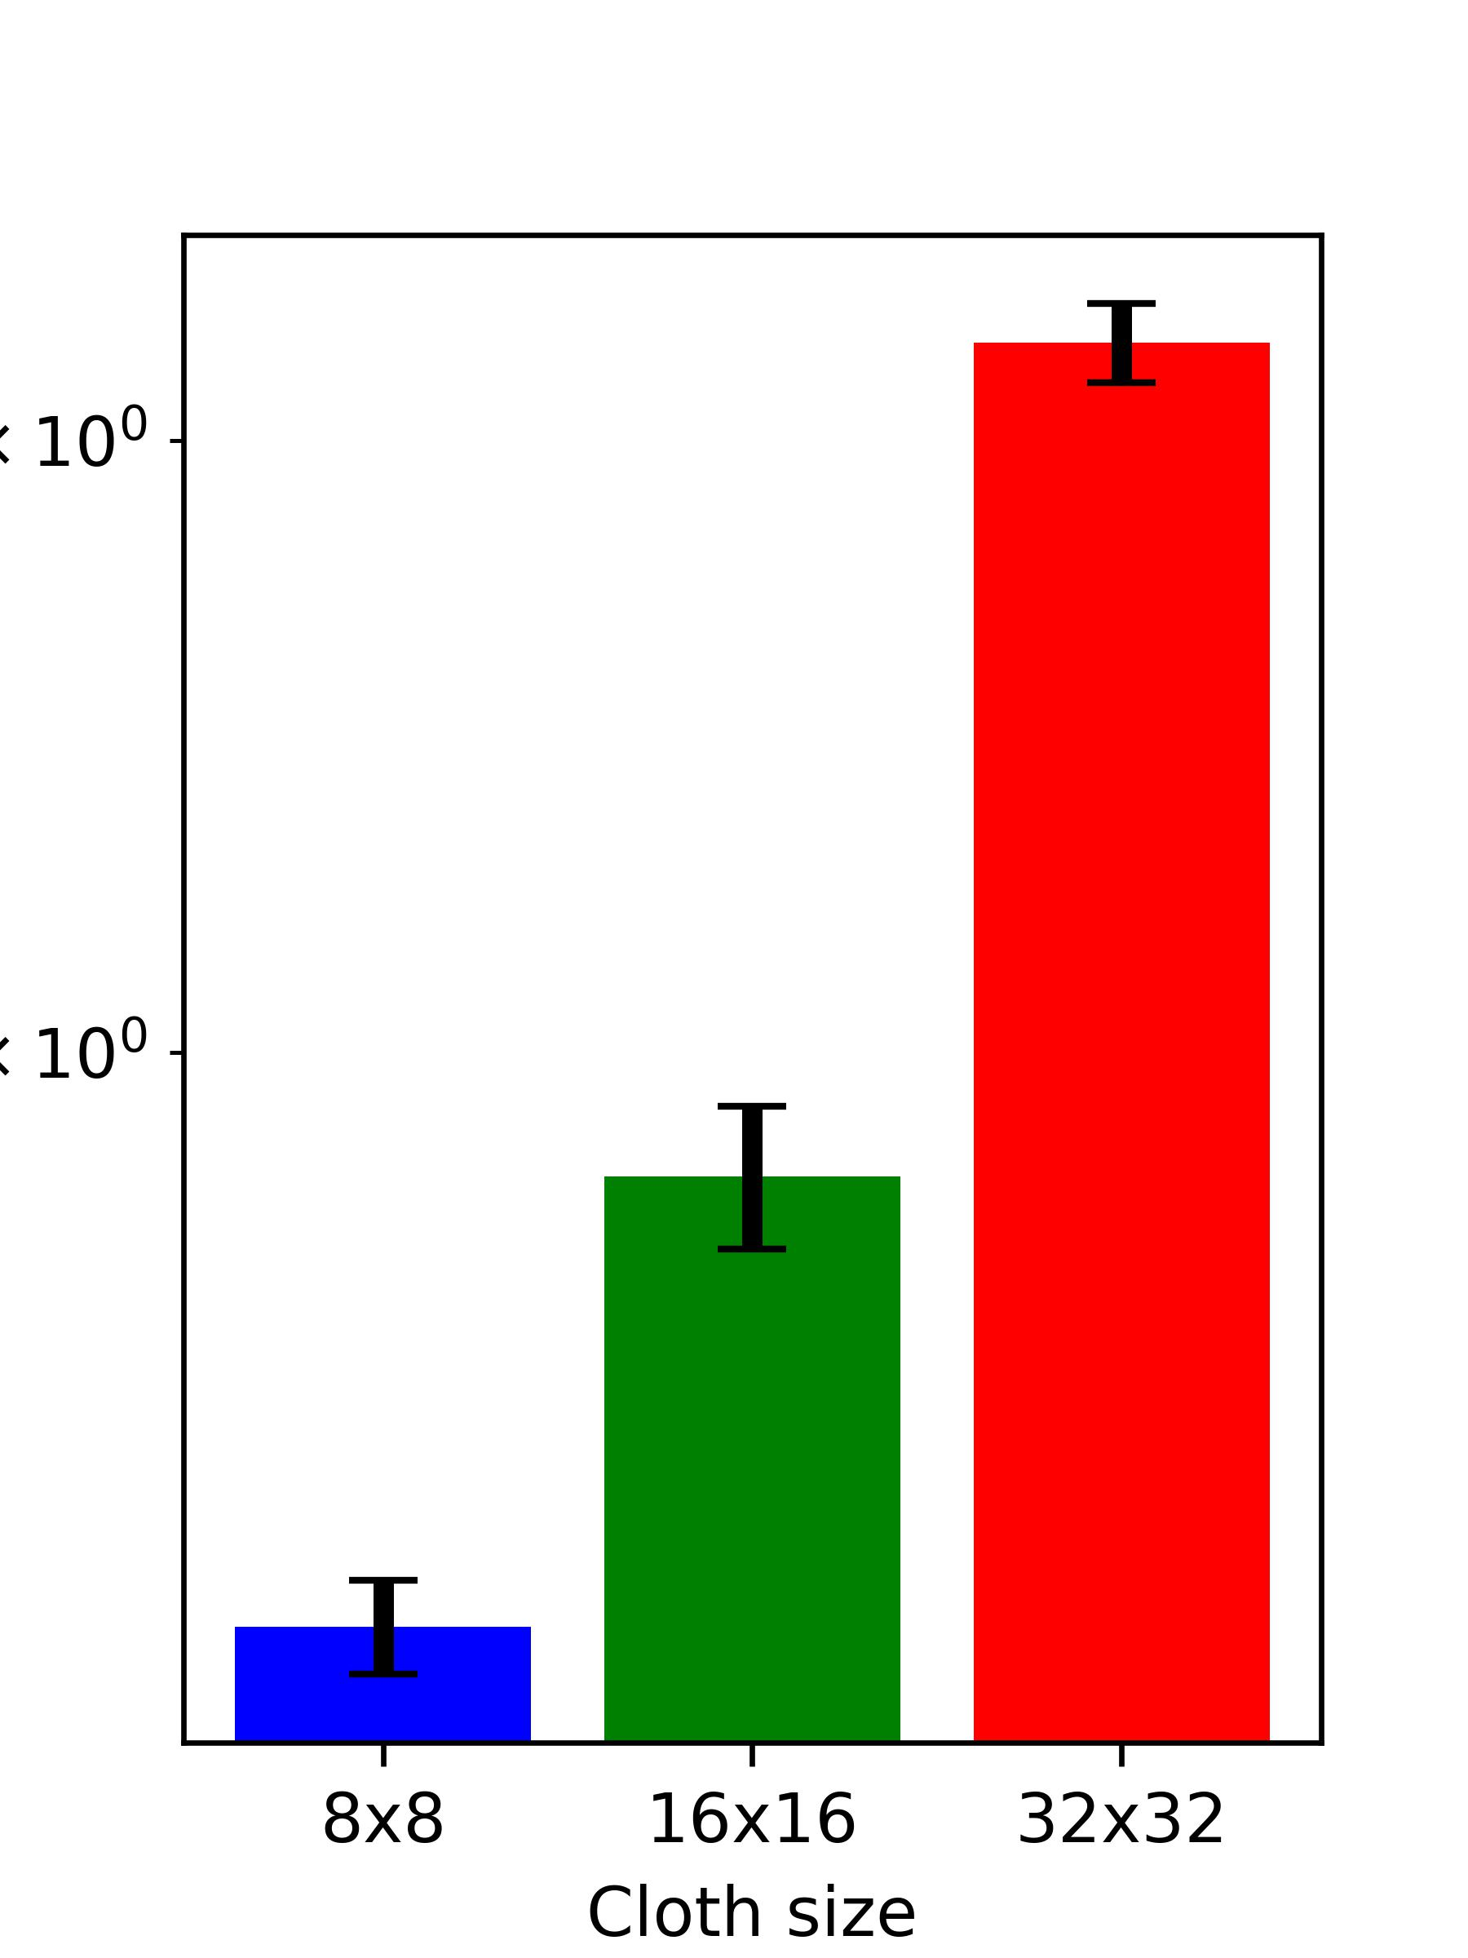
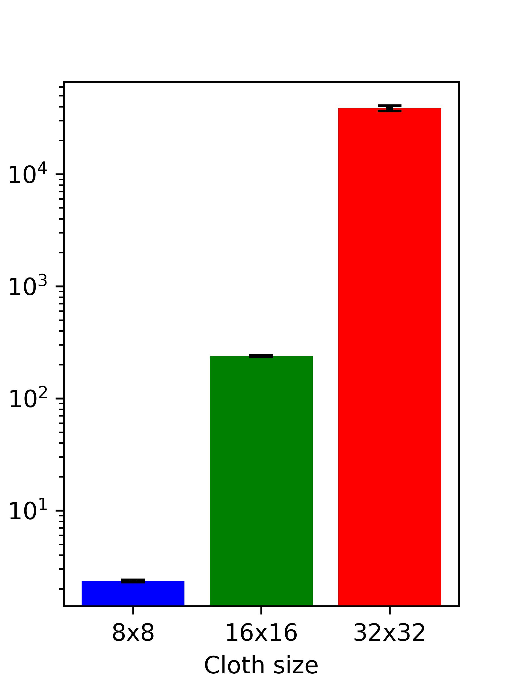
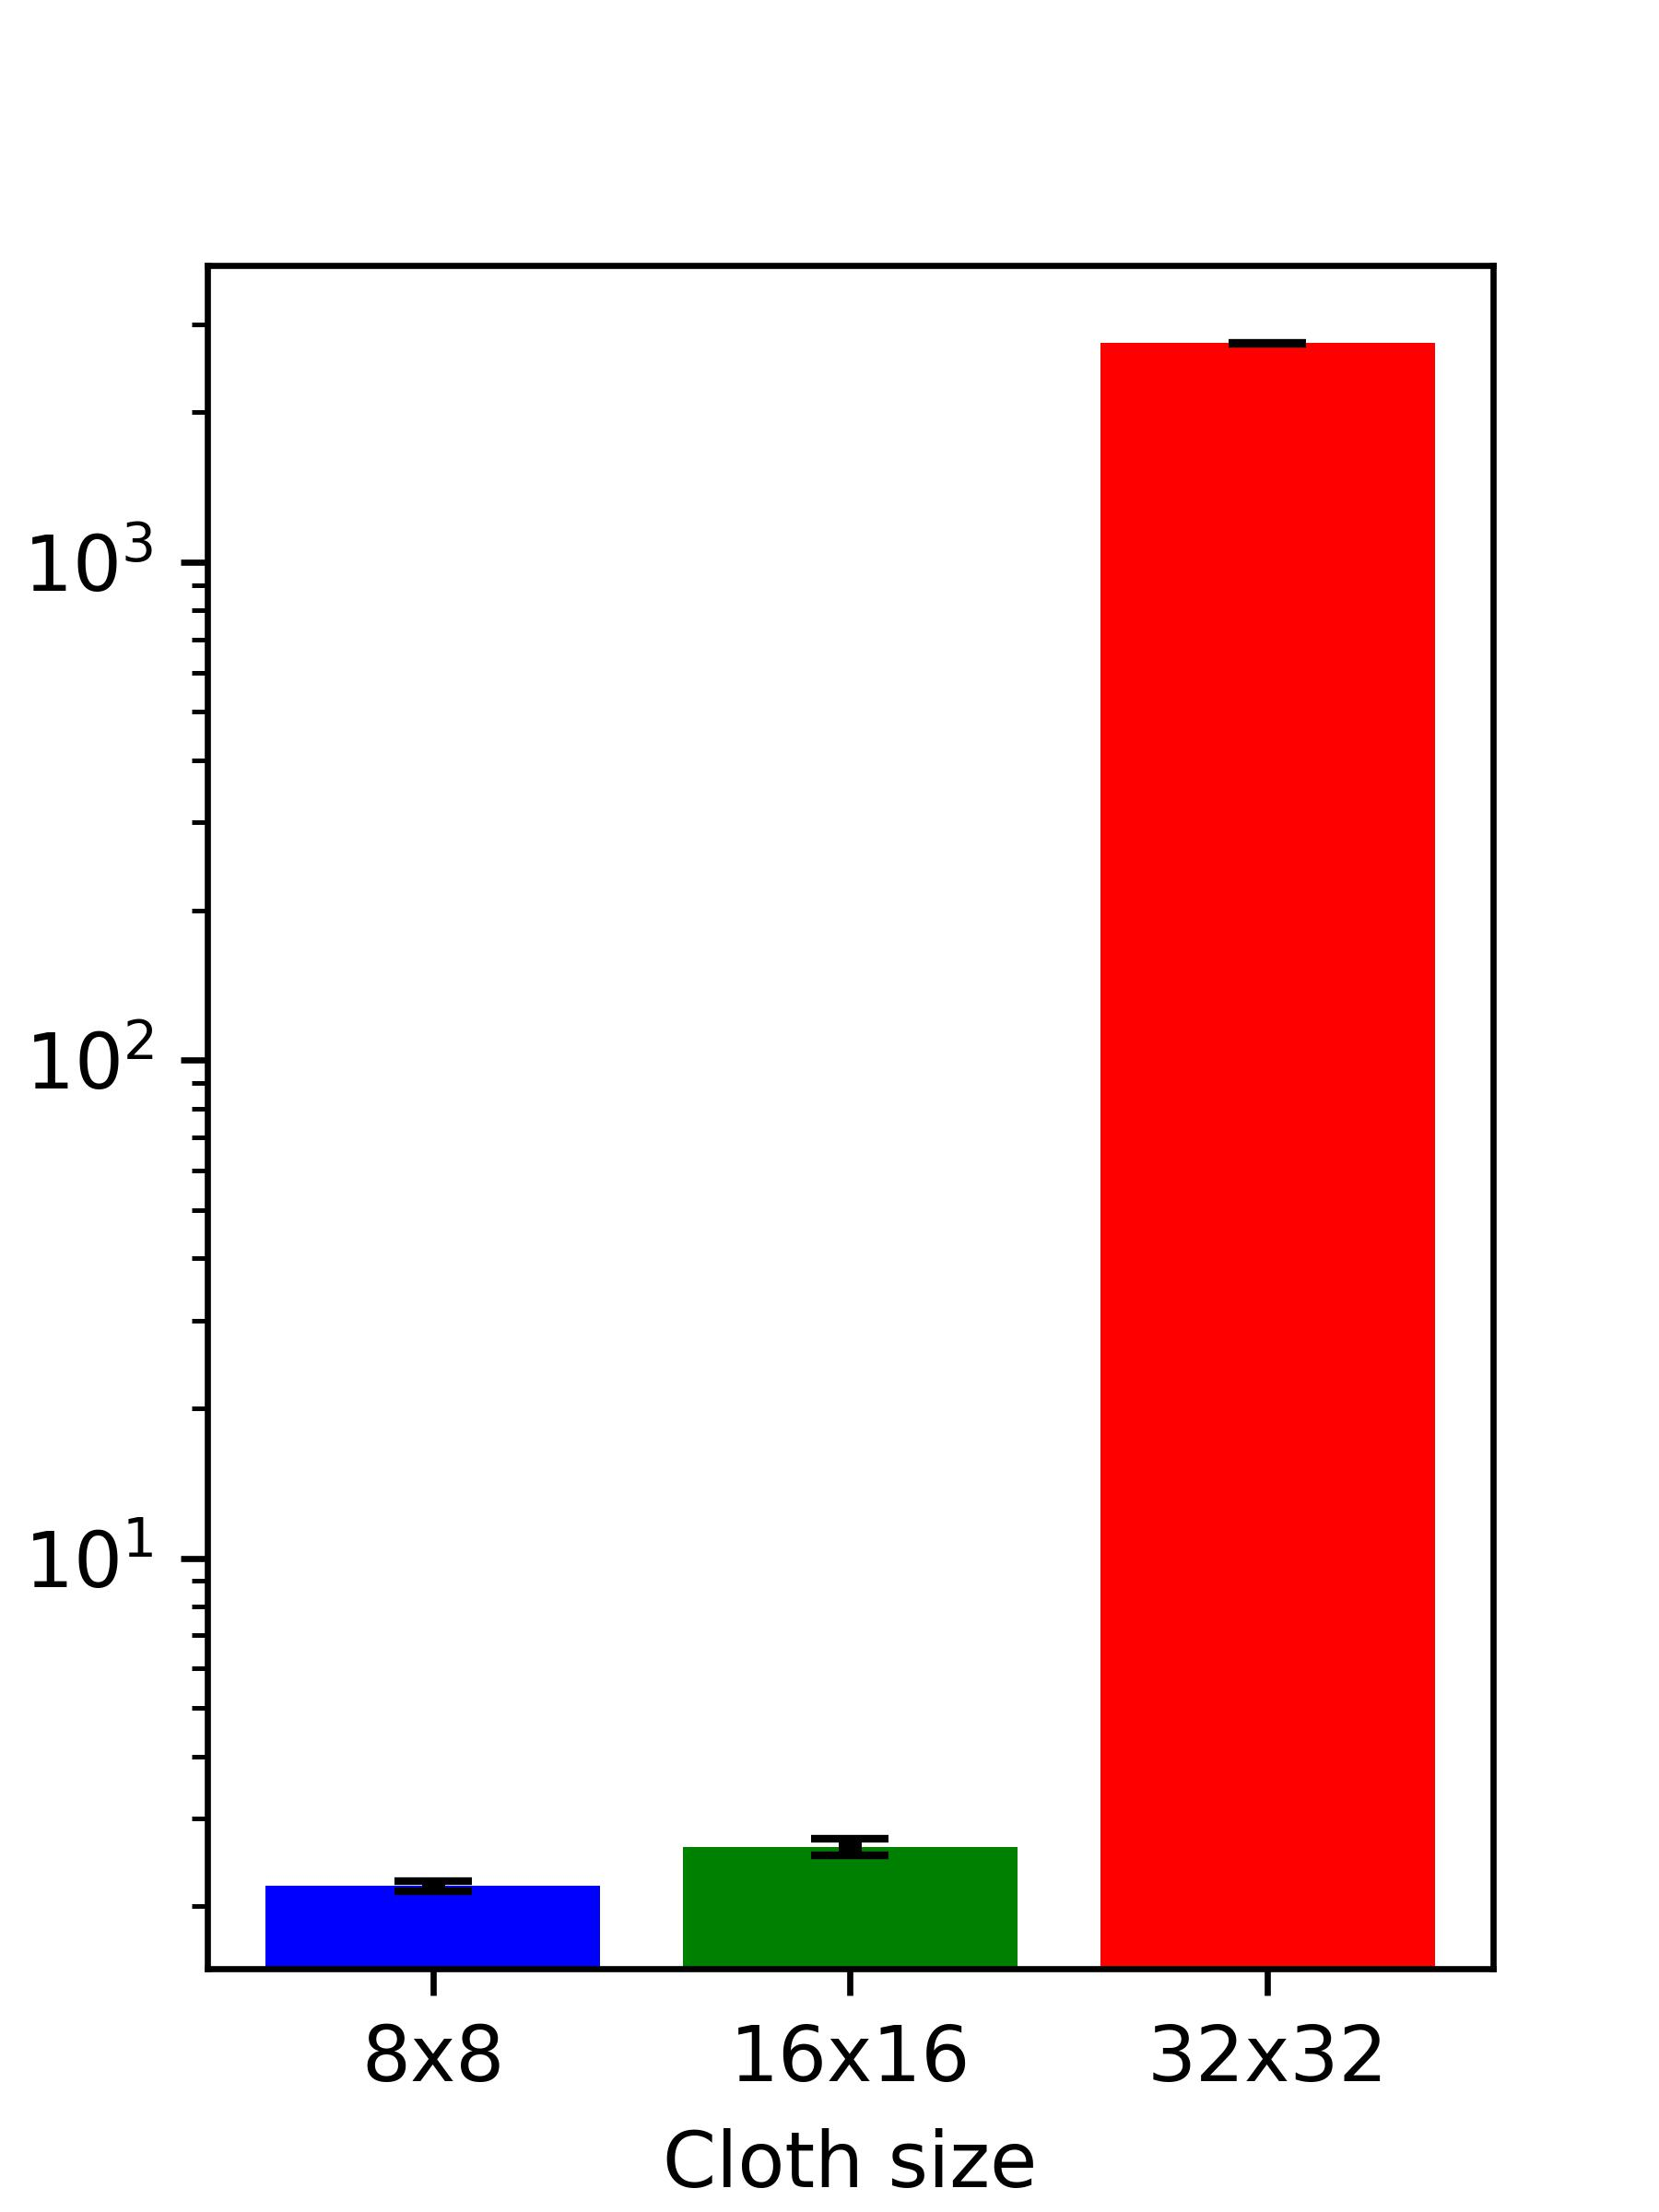
Vertices number
Explicit Euler
Implicit Euler
Fast method
Time / Frame (ms)
Notes:
In our model, if we divide the piece of cloth to more vertices connected by spring

Slide 10
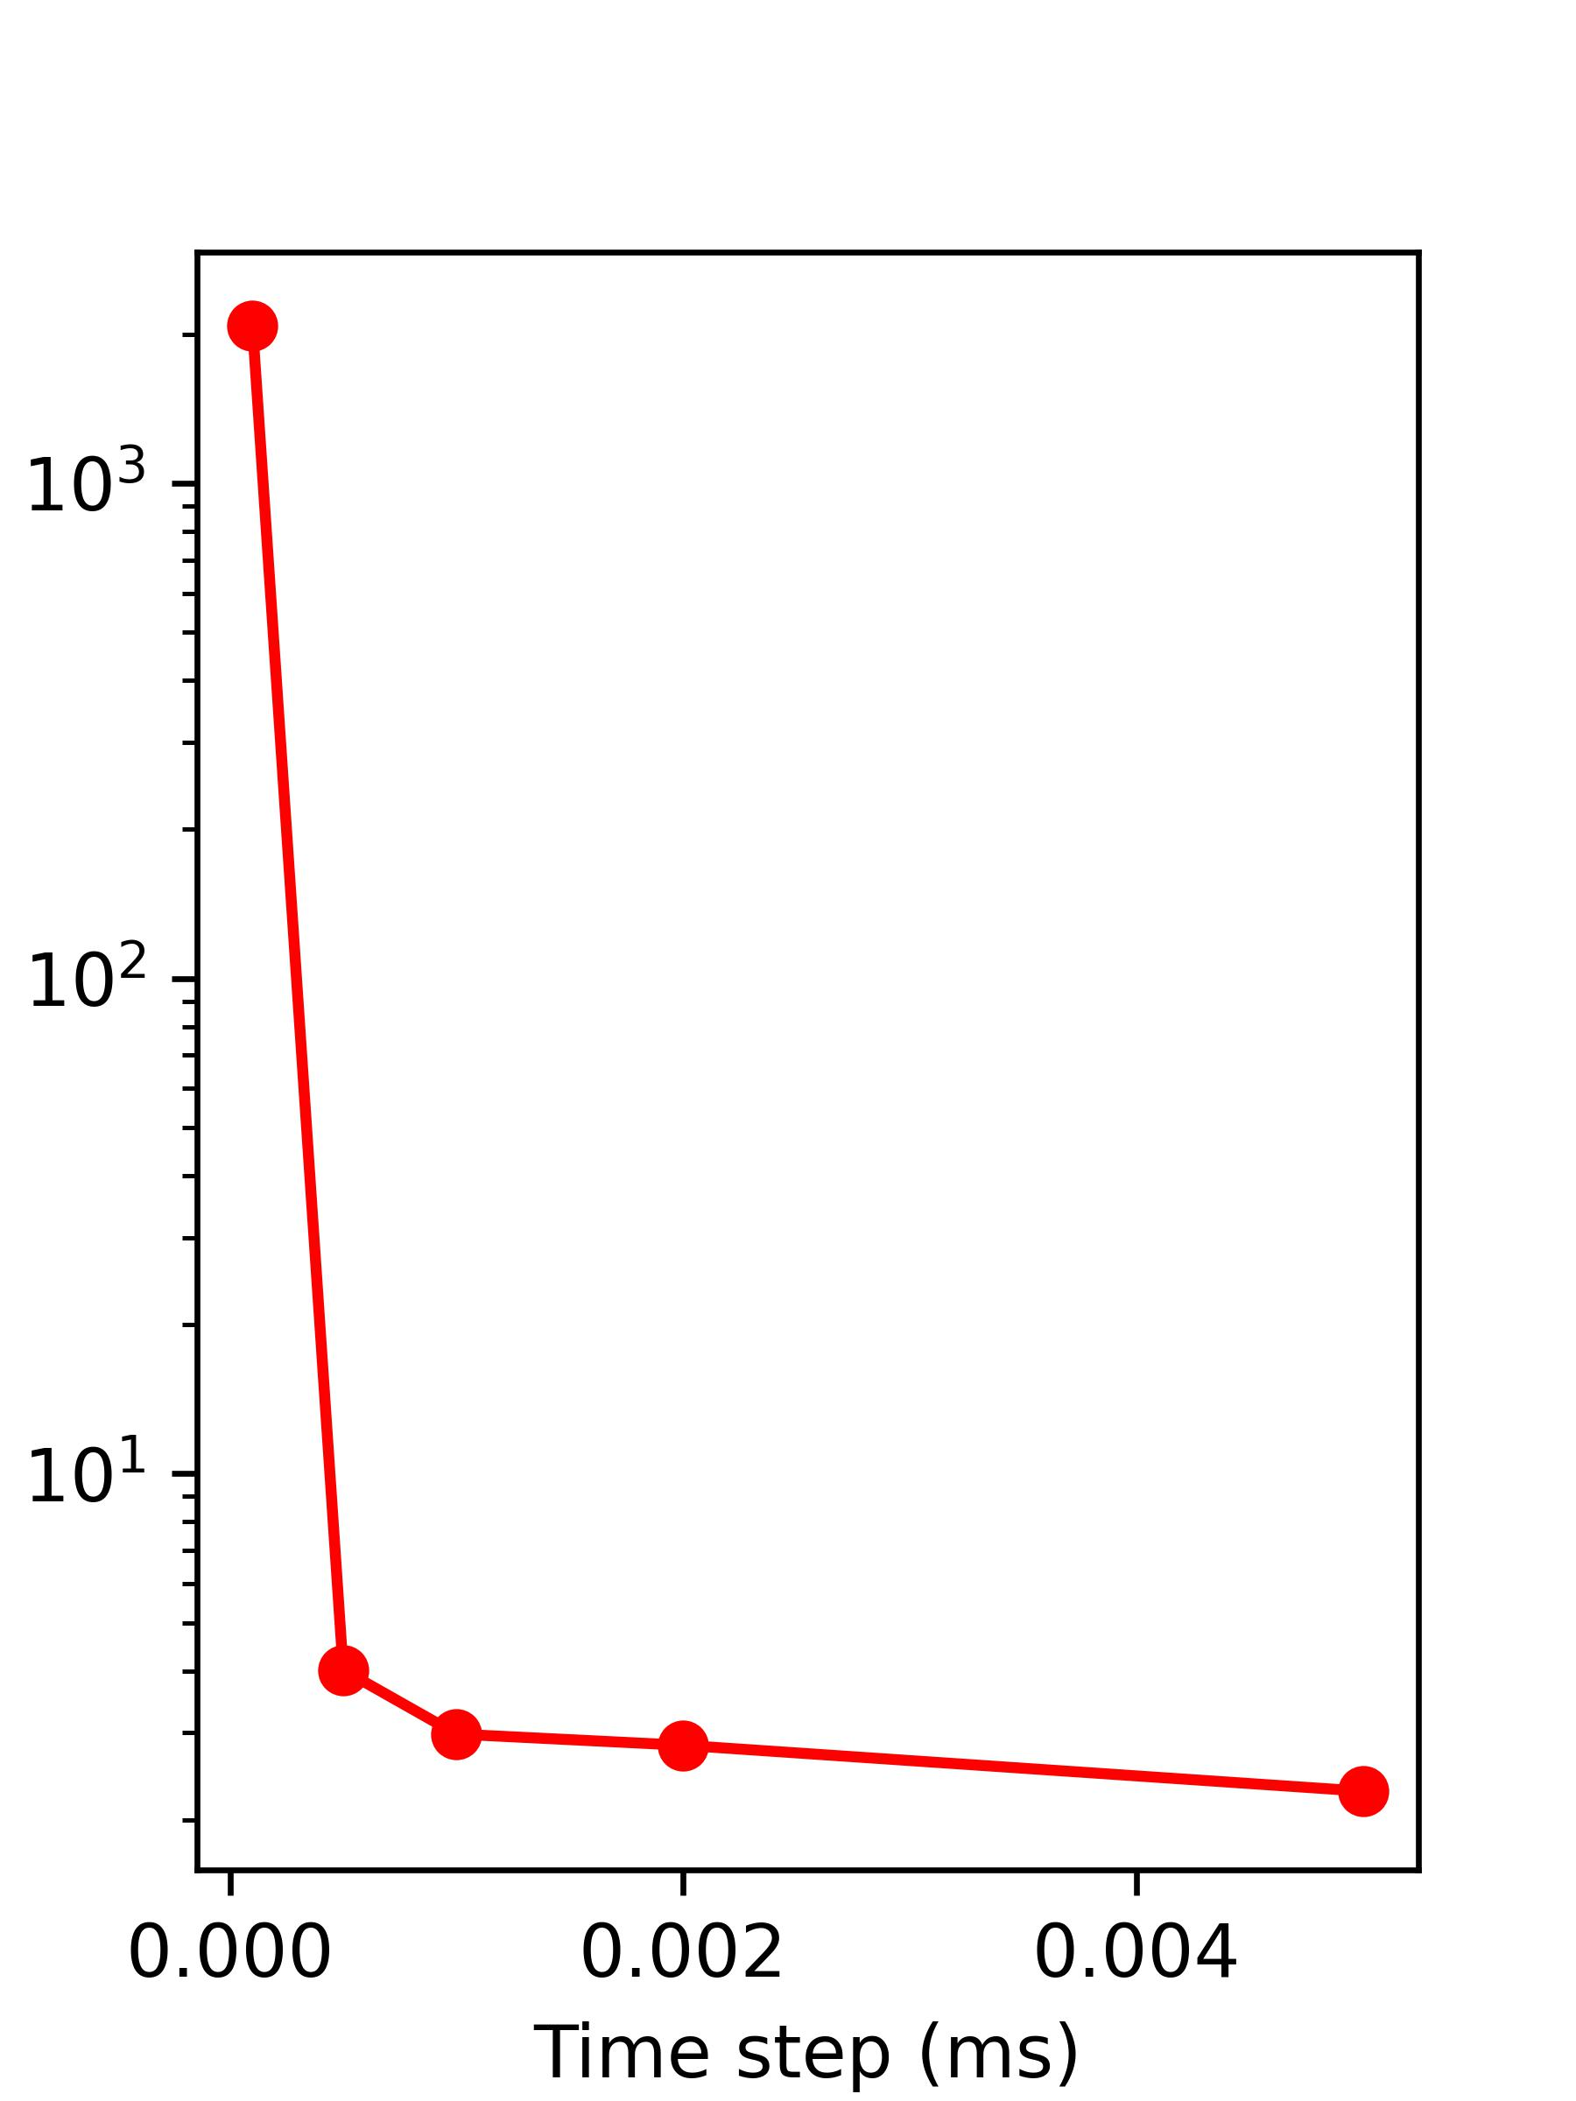
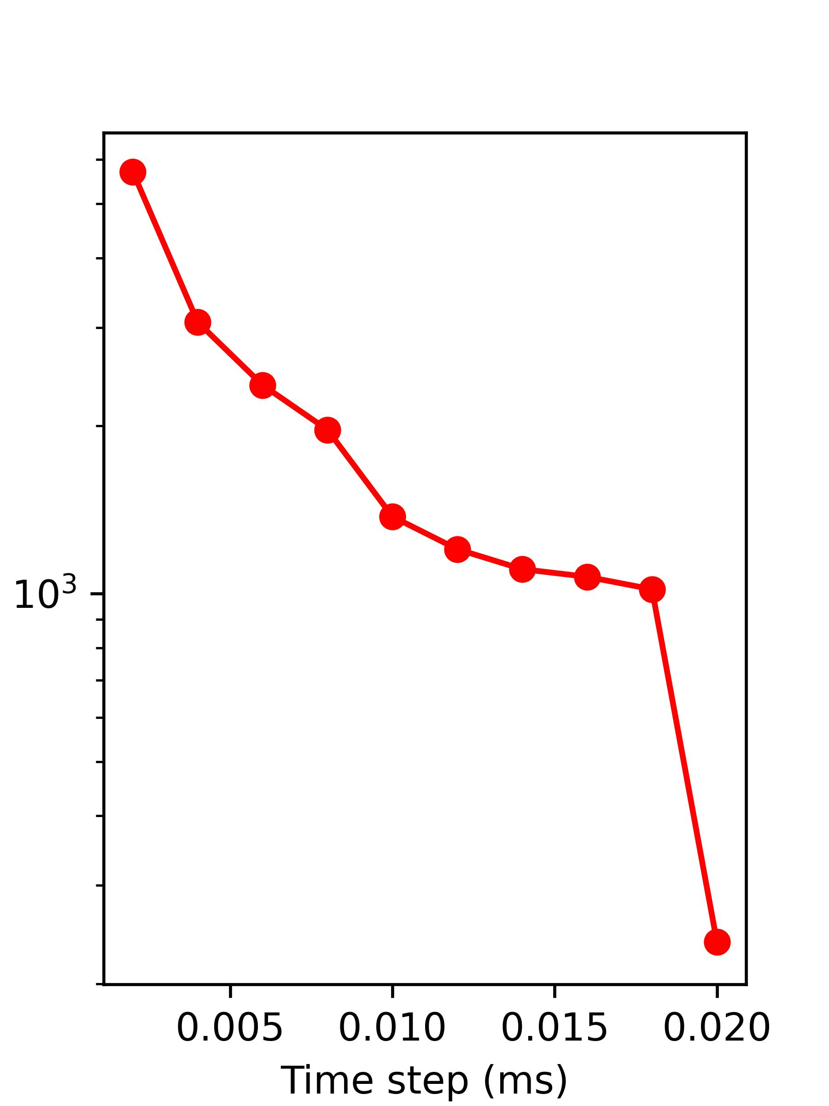
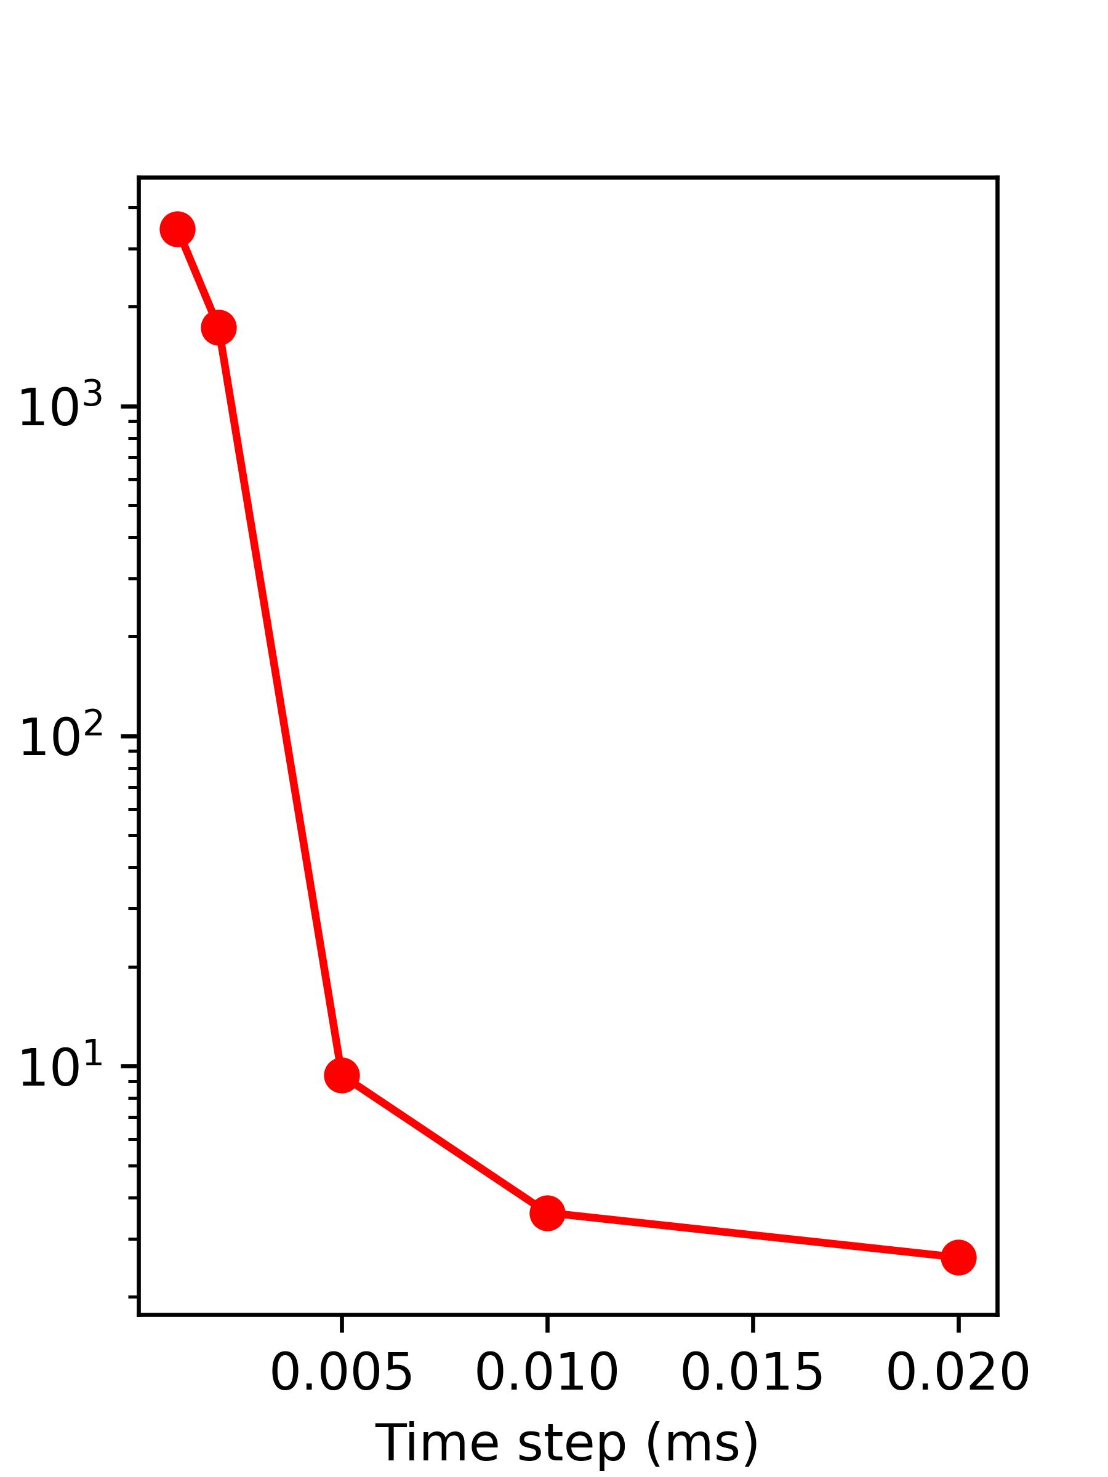
Time step
Explicit Euler
Implicit Euler
Fast method
Time / Frame (ms)
Notes:
And for different integrate time step,

Slide 11
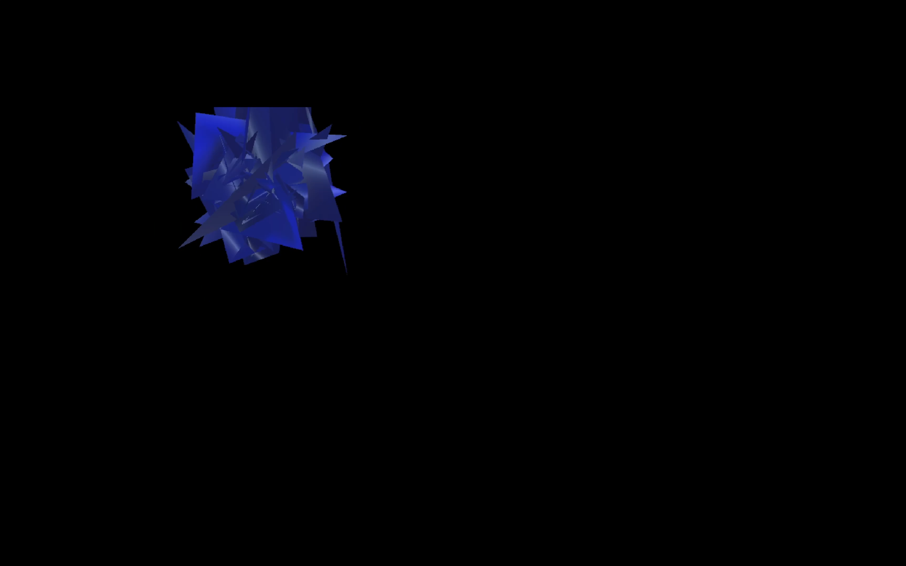
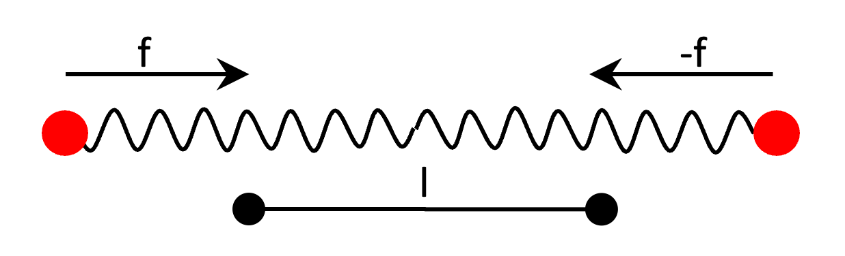
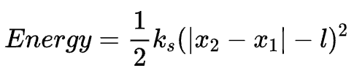
Stability
Notes:
Complex model,
If we want to get the perfect calculation, we might need a very strong computer (that’s impossible for), or we have to lost the accuracy,
Sometimes, if same fault happen, the it has a large amount of positive feedback, small distraction would be accumulated by the integration and cause all variables to rapidly increase to ridiculous values,
And to measure the stability of different methods, we can use the total energy of the springs, that’s because when everything lost control, energy of spring would also be very bi

Slide 12
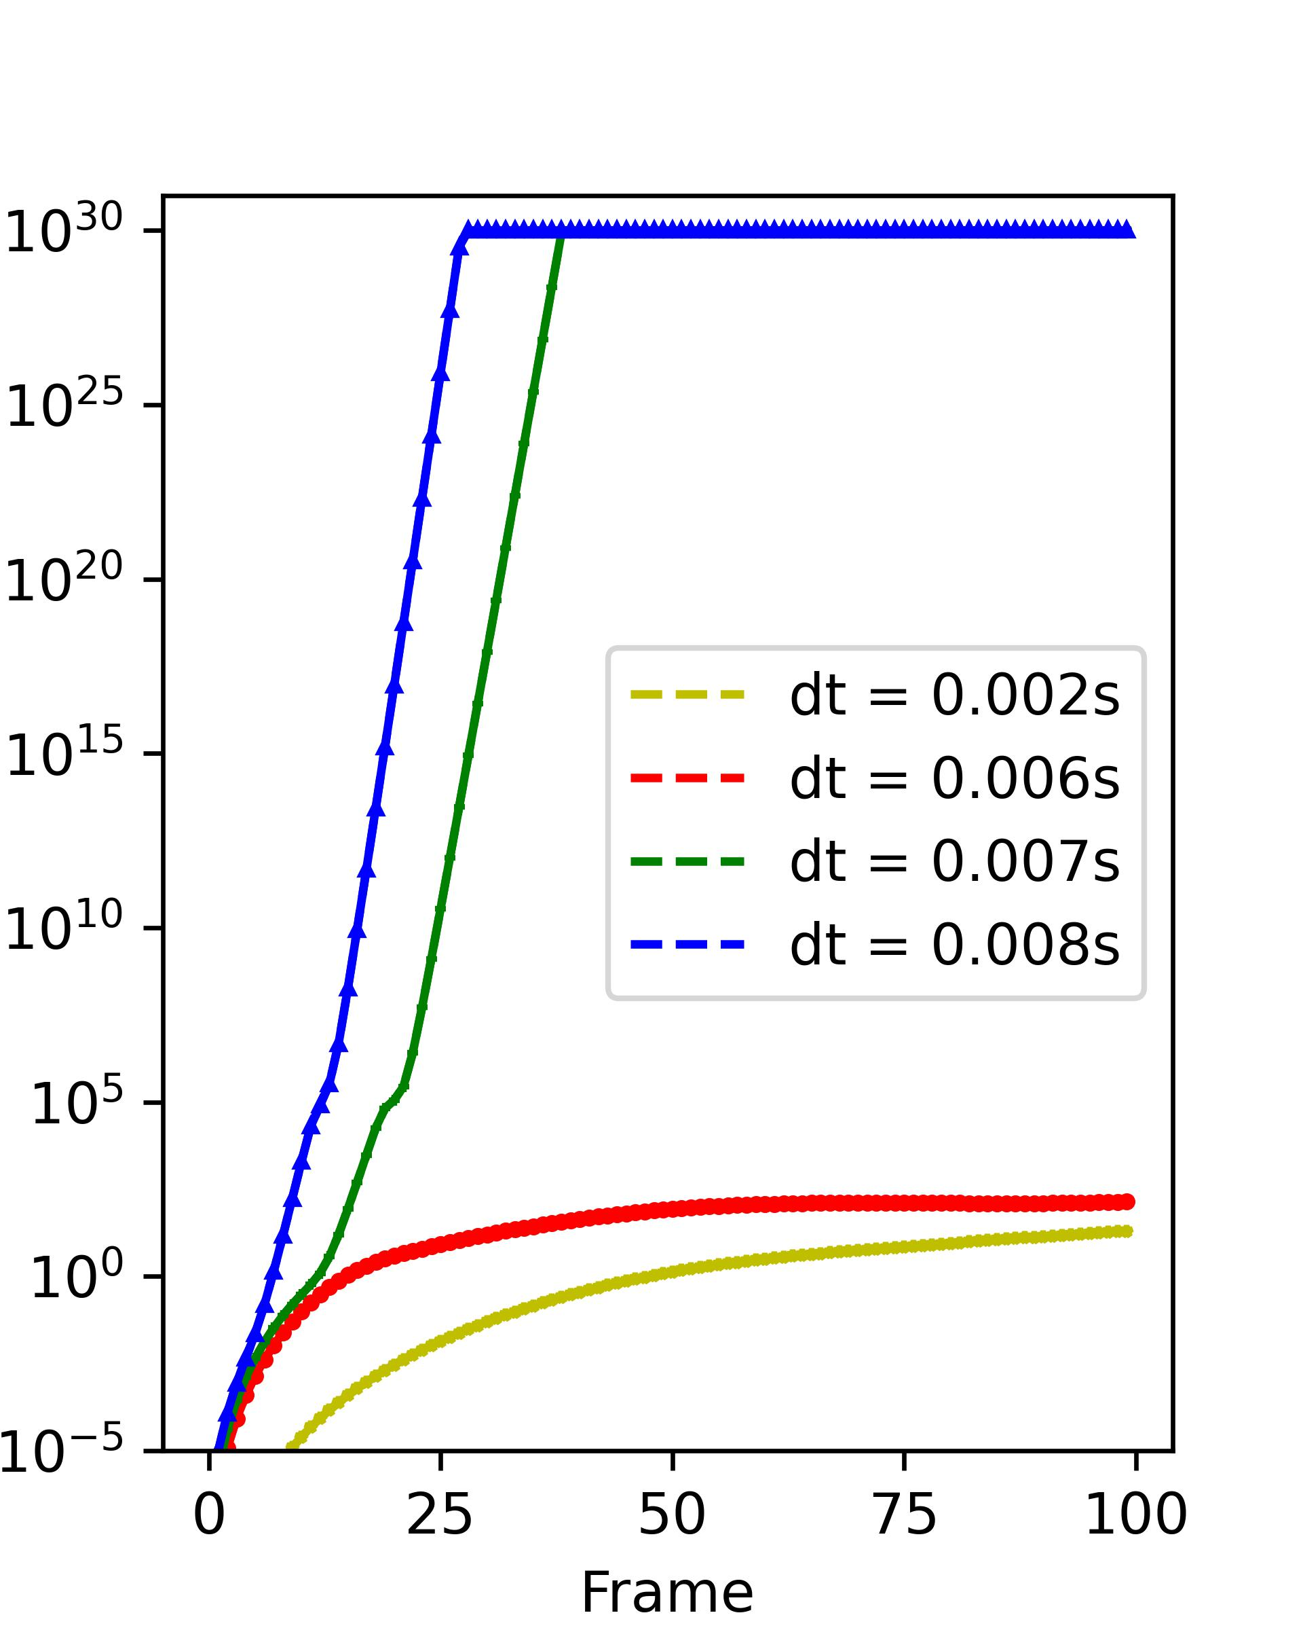
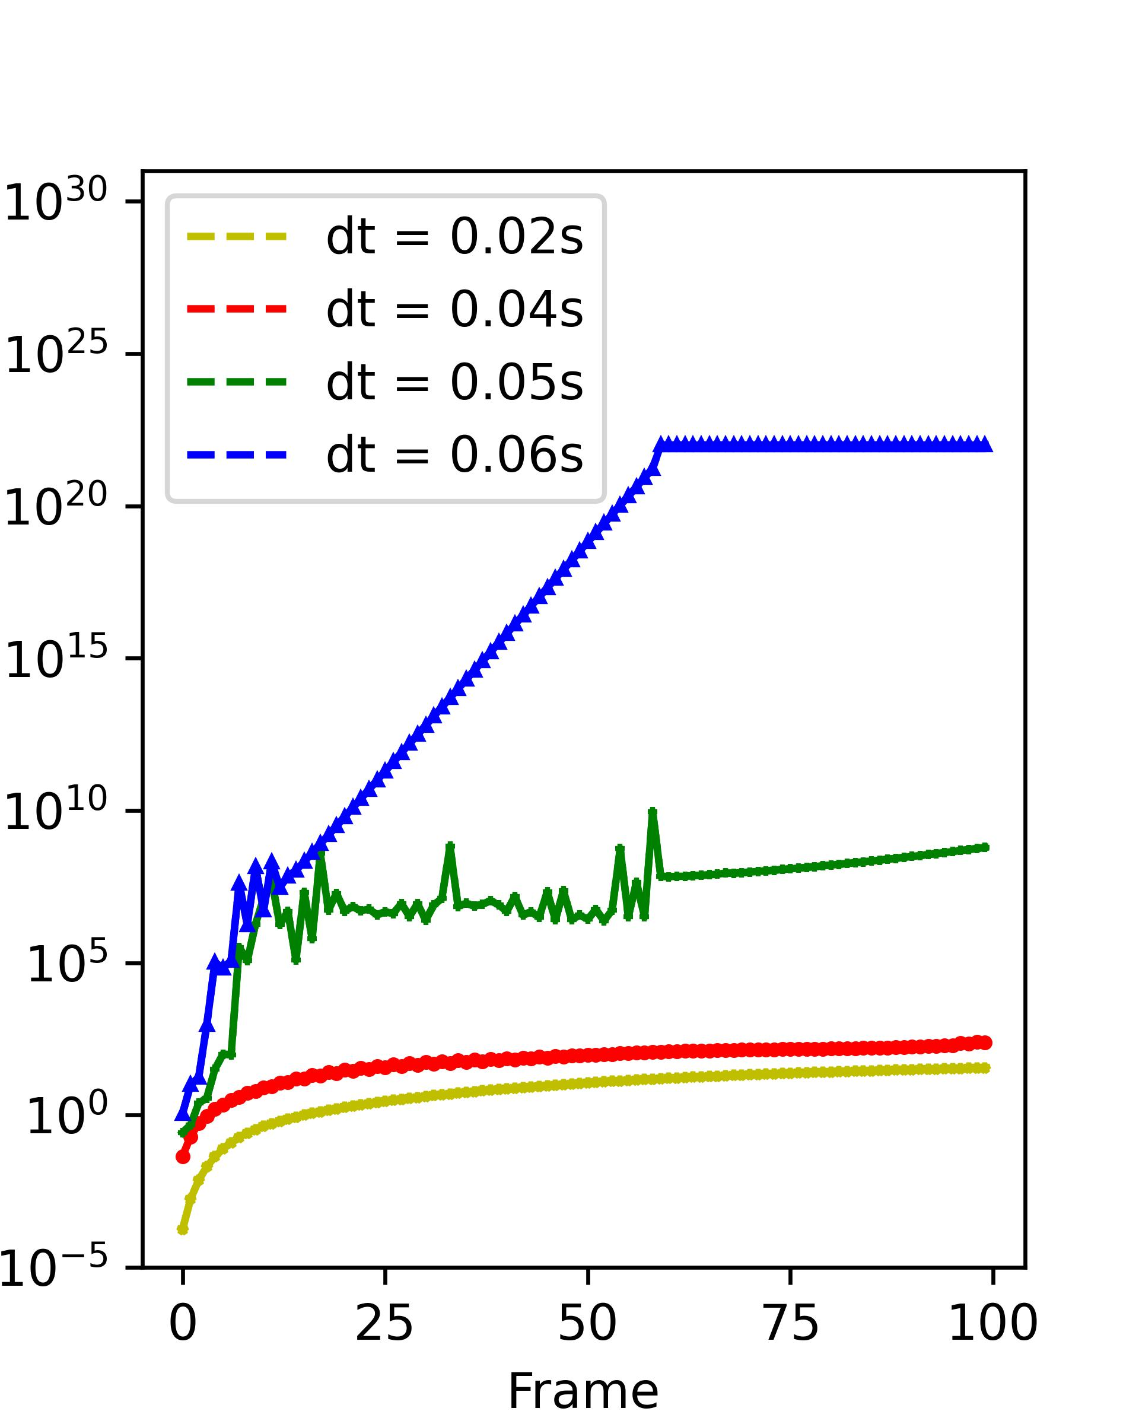
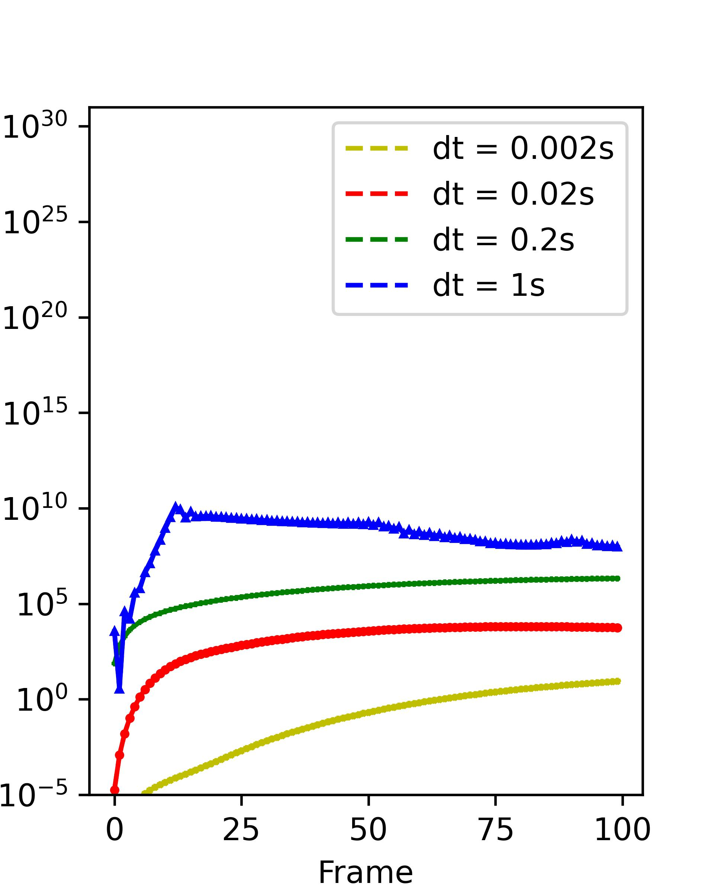
Stability
Explicit Euler
Implicit Euler
Fast method
Spring Energy
Notes:
Overflow，

Slide 13
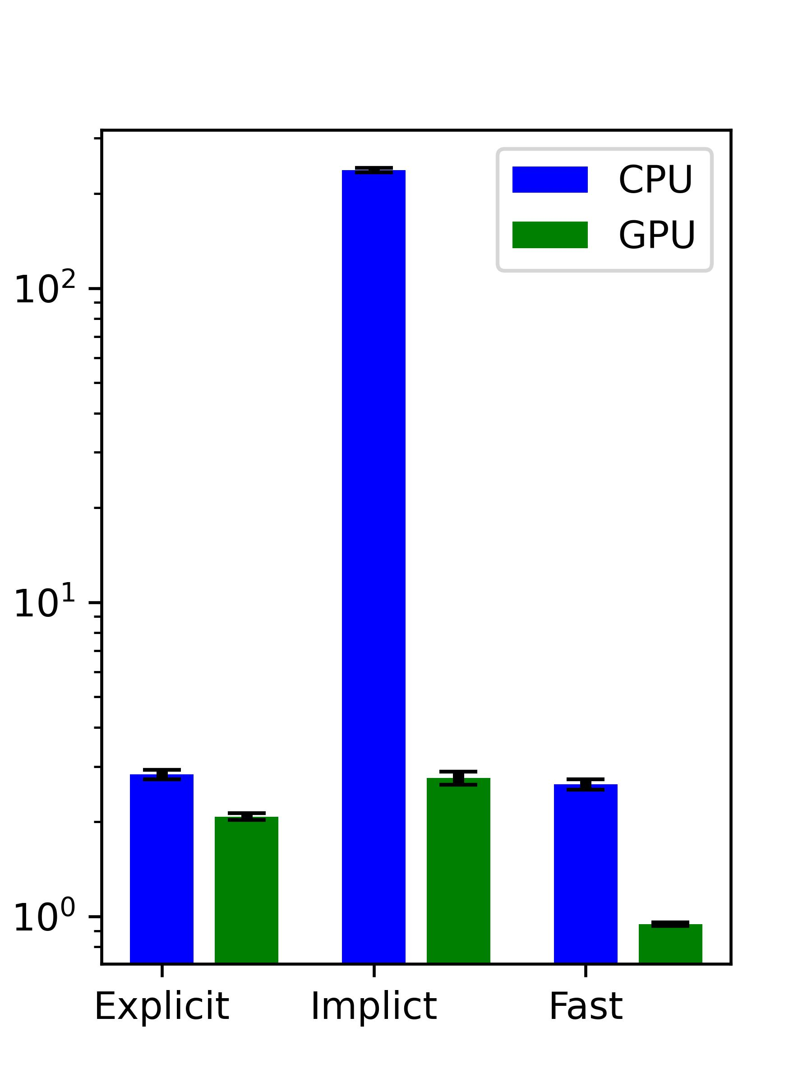
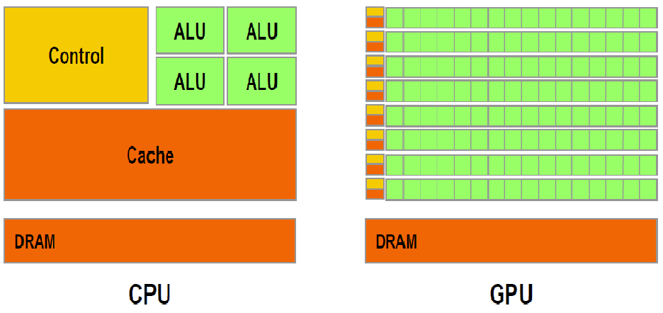
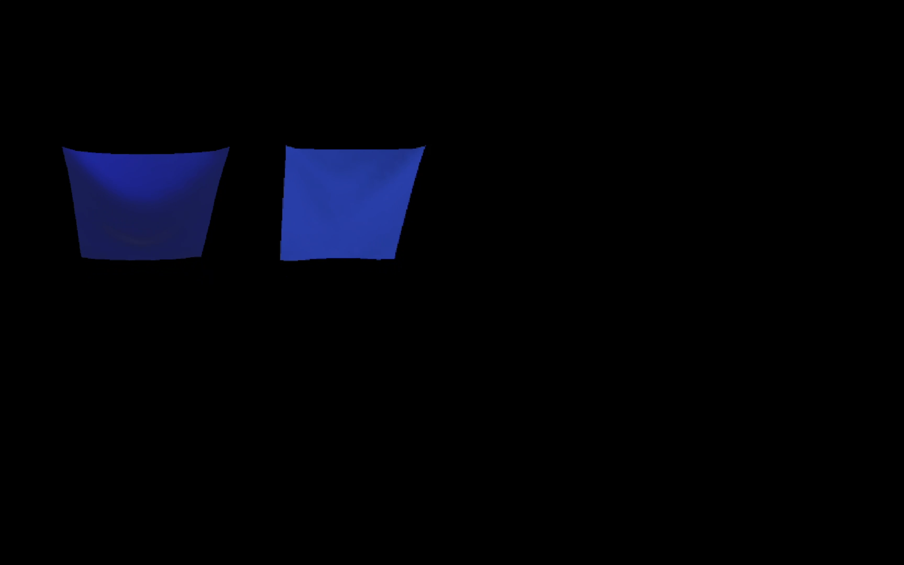
GPU or CPU ?
Time / Frame (ms)
Notes:
Problem, trade off between stable and fast,
GPUs can perform parallel operations on multiple sets of data at same time,

Slide 14
Control
ALU
ALU
ALU
ALU
Cache
DRAM
DRAM
CPU
GPU

Slide 15
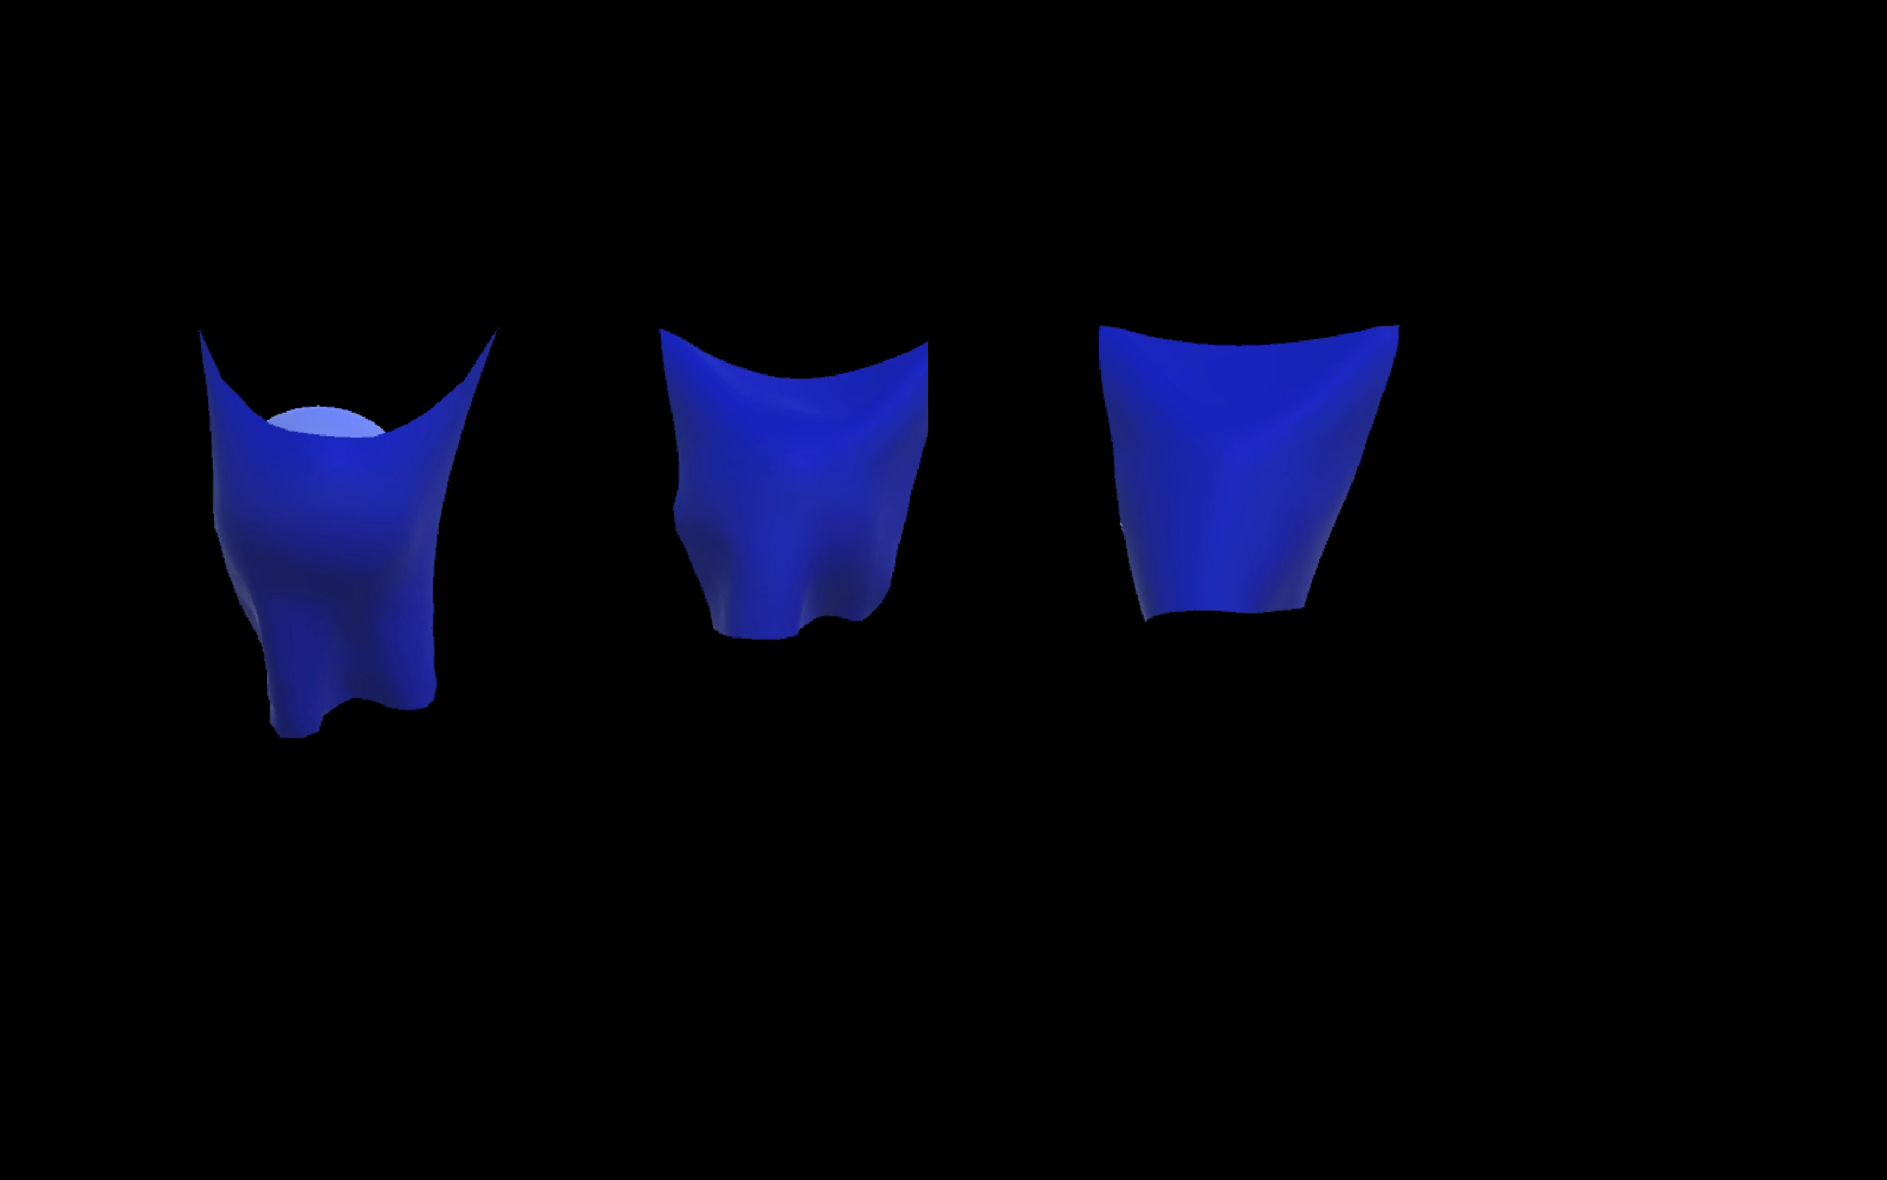
Parameters → different fabric texture
k_{s} = 1000
k_{s} = 10,000
k_{s} = 100,000
Notes:
fabric texture
Silk, linen

Slide 16
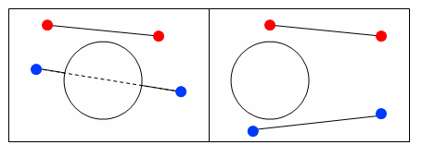
Collisions
Cloth-Object Collisions
Cloth-Cloth Collisions
Notes:
There is no avoiding it; collisions are very hard to deal with when it comes to cloth.

Slide 17
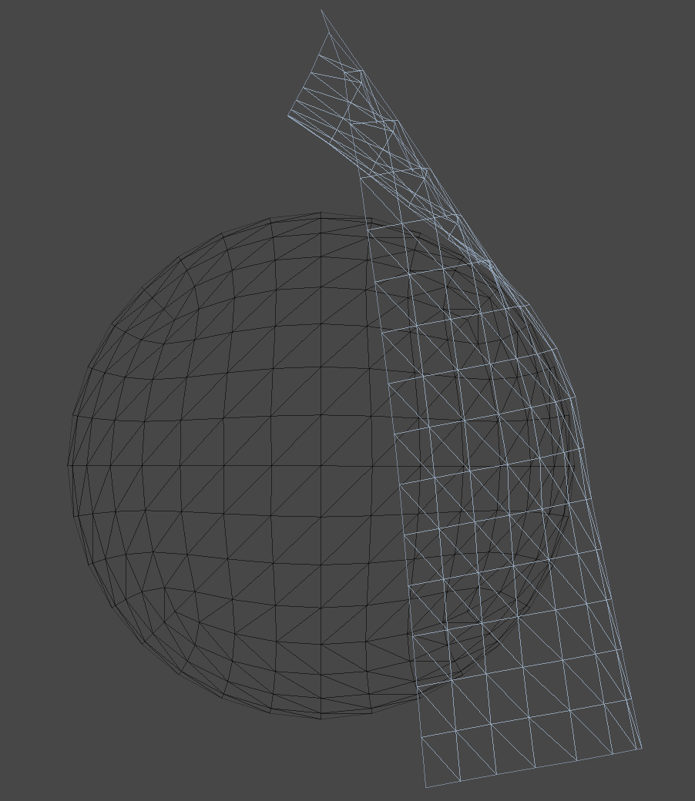
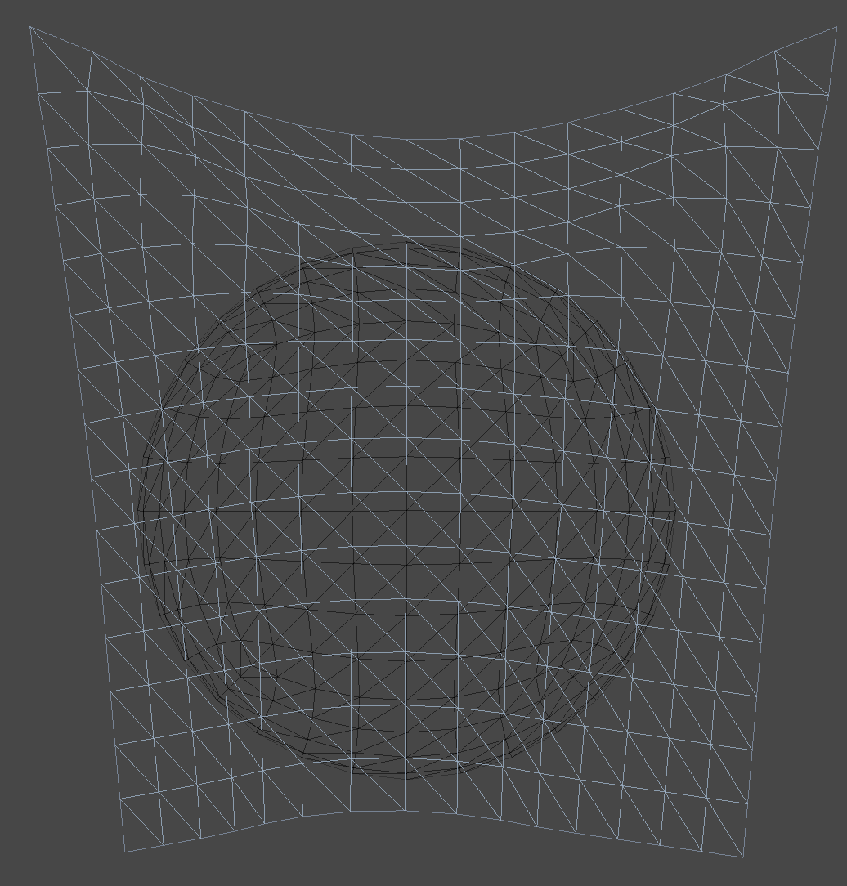
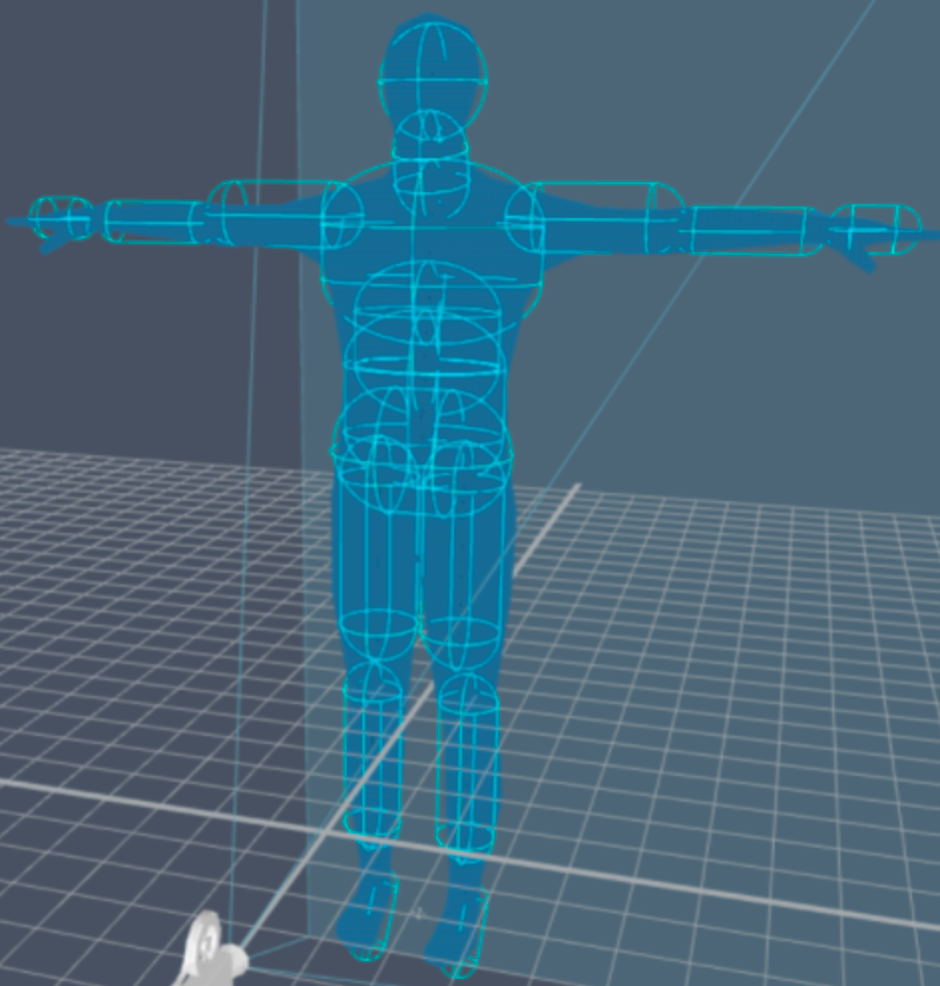
Collision with other object
Notes:
Generally the easier of the two types of collisions to deal with, we assume we have some solid objects in the scene, and independent of their motion, their position at and around time t is fixed and known. These objects might be represented as geometric primitives (cylinders, spheres, cubes, etc.) or the interior of a mesh.

Slide 18
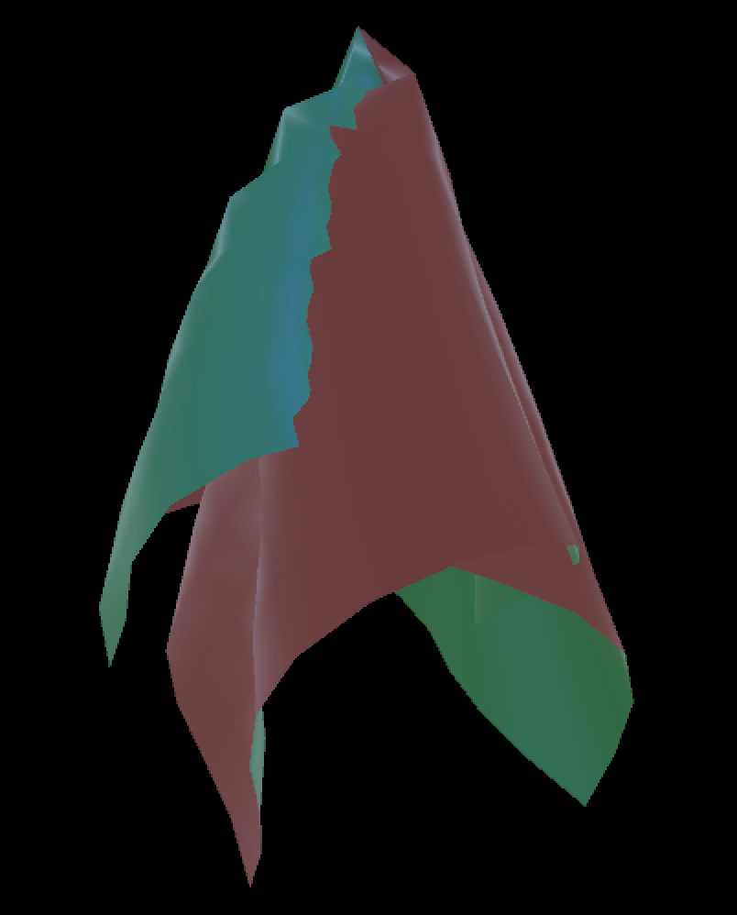
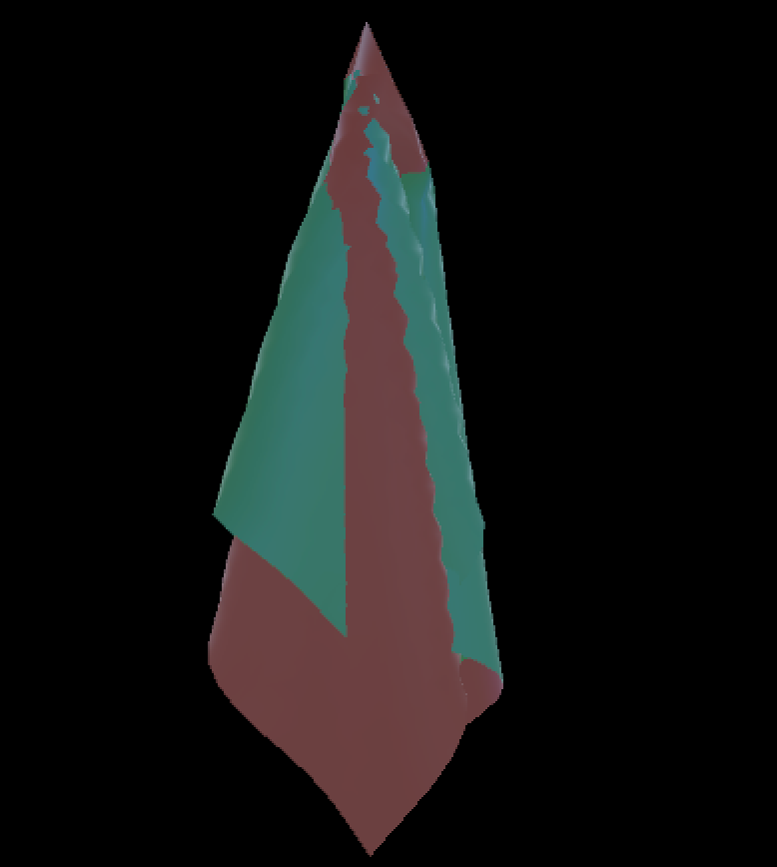
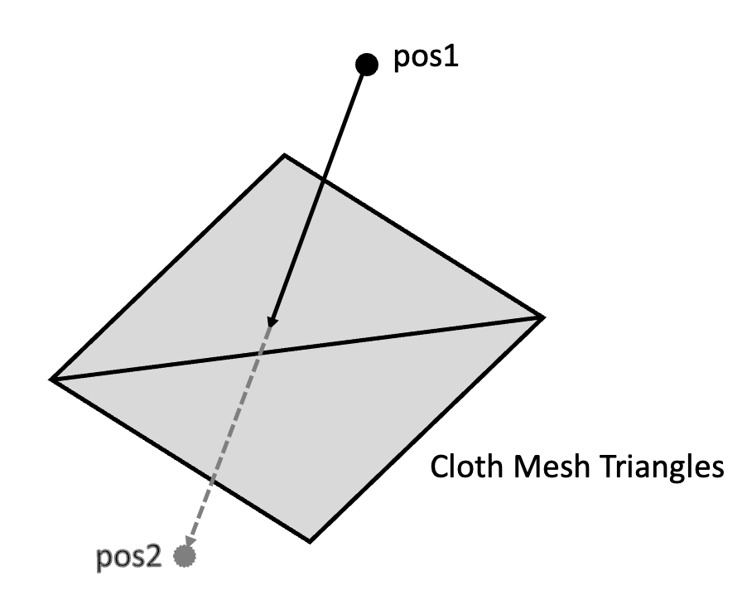
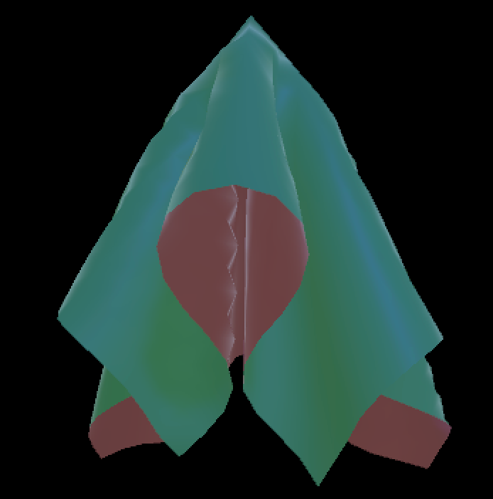
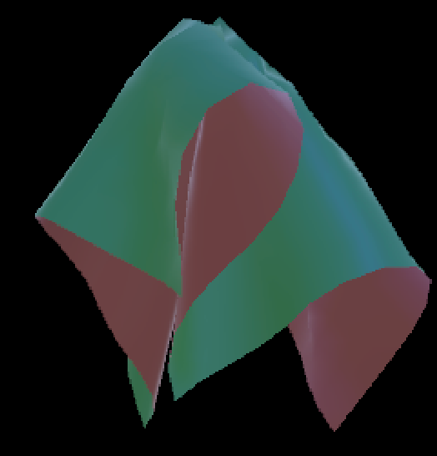
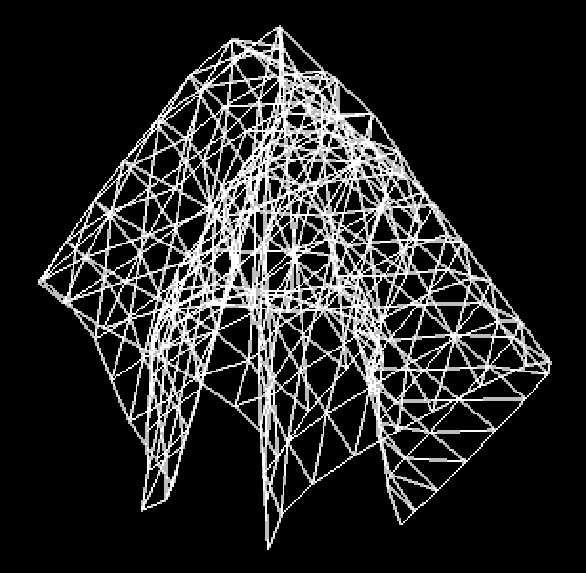
Self–collision
Problems:
Cost increase
Lost stable
Notes:
Cloth looks very unrealistic if it passes through itself.
we have A simple solution

Slide 19
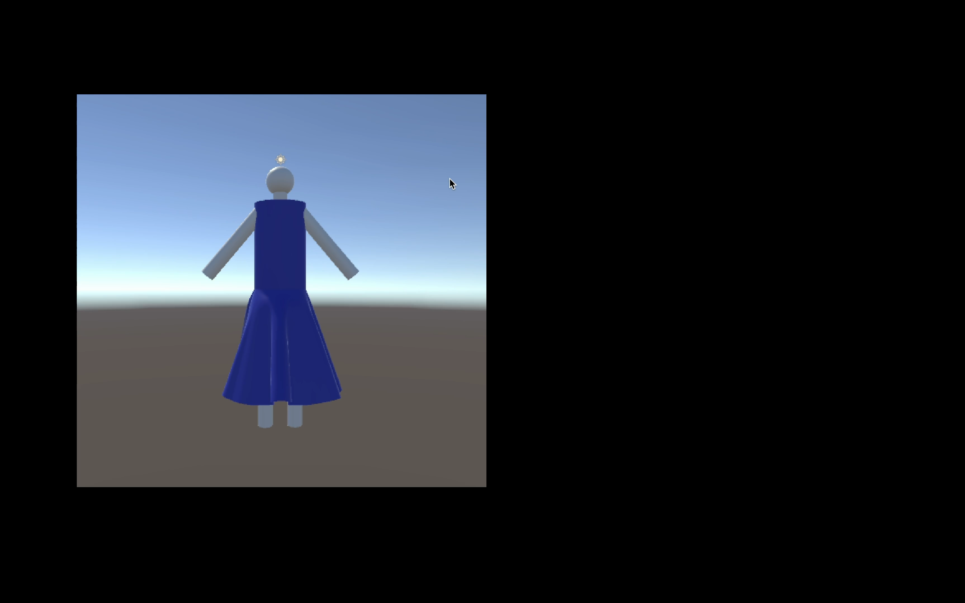
Further implements

Slide 20
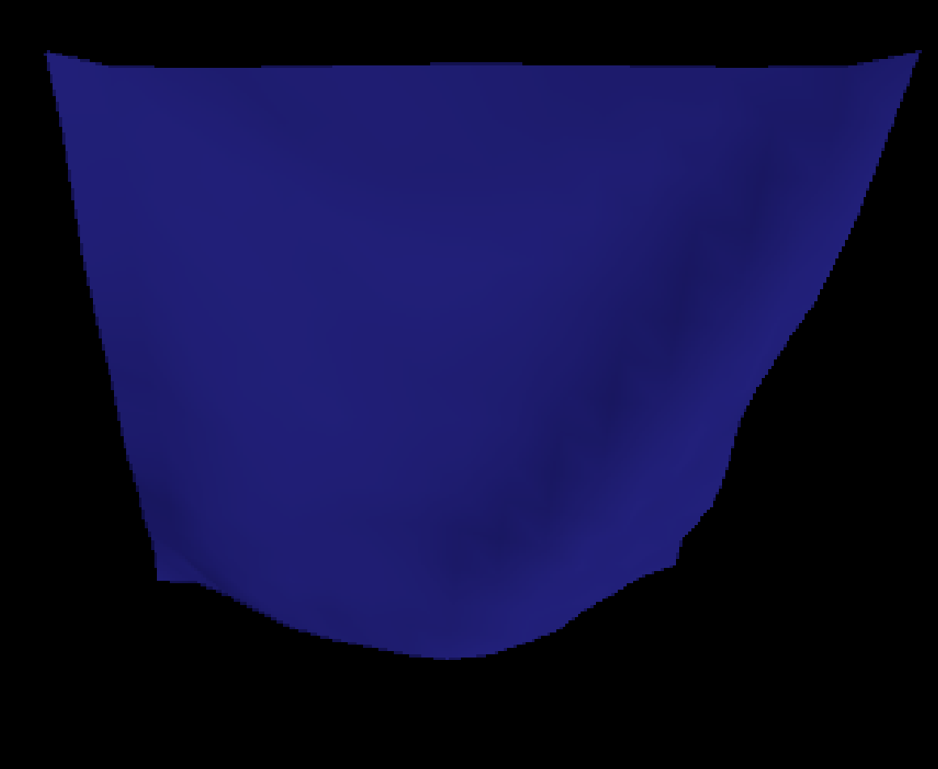

On CPU
On GPU

Slide 21
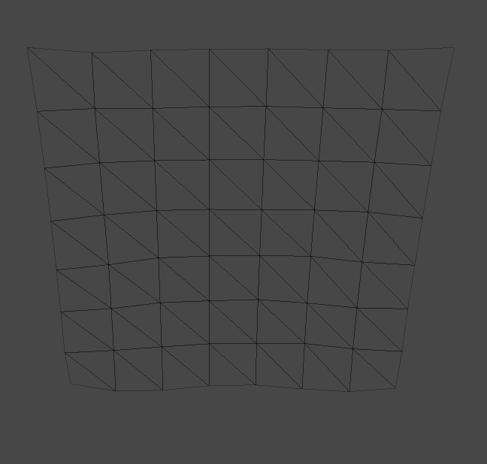





8x8
16x16
32x32

Slide 22



Explicit Euler
Implicit Euler
Fast simulation

